Slide 1
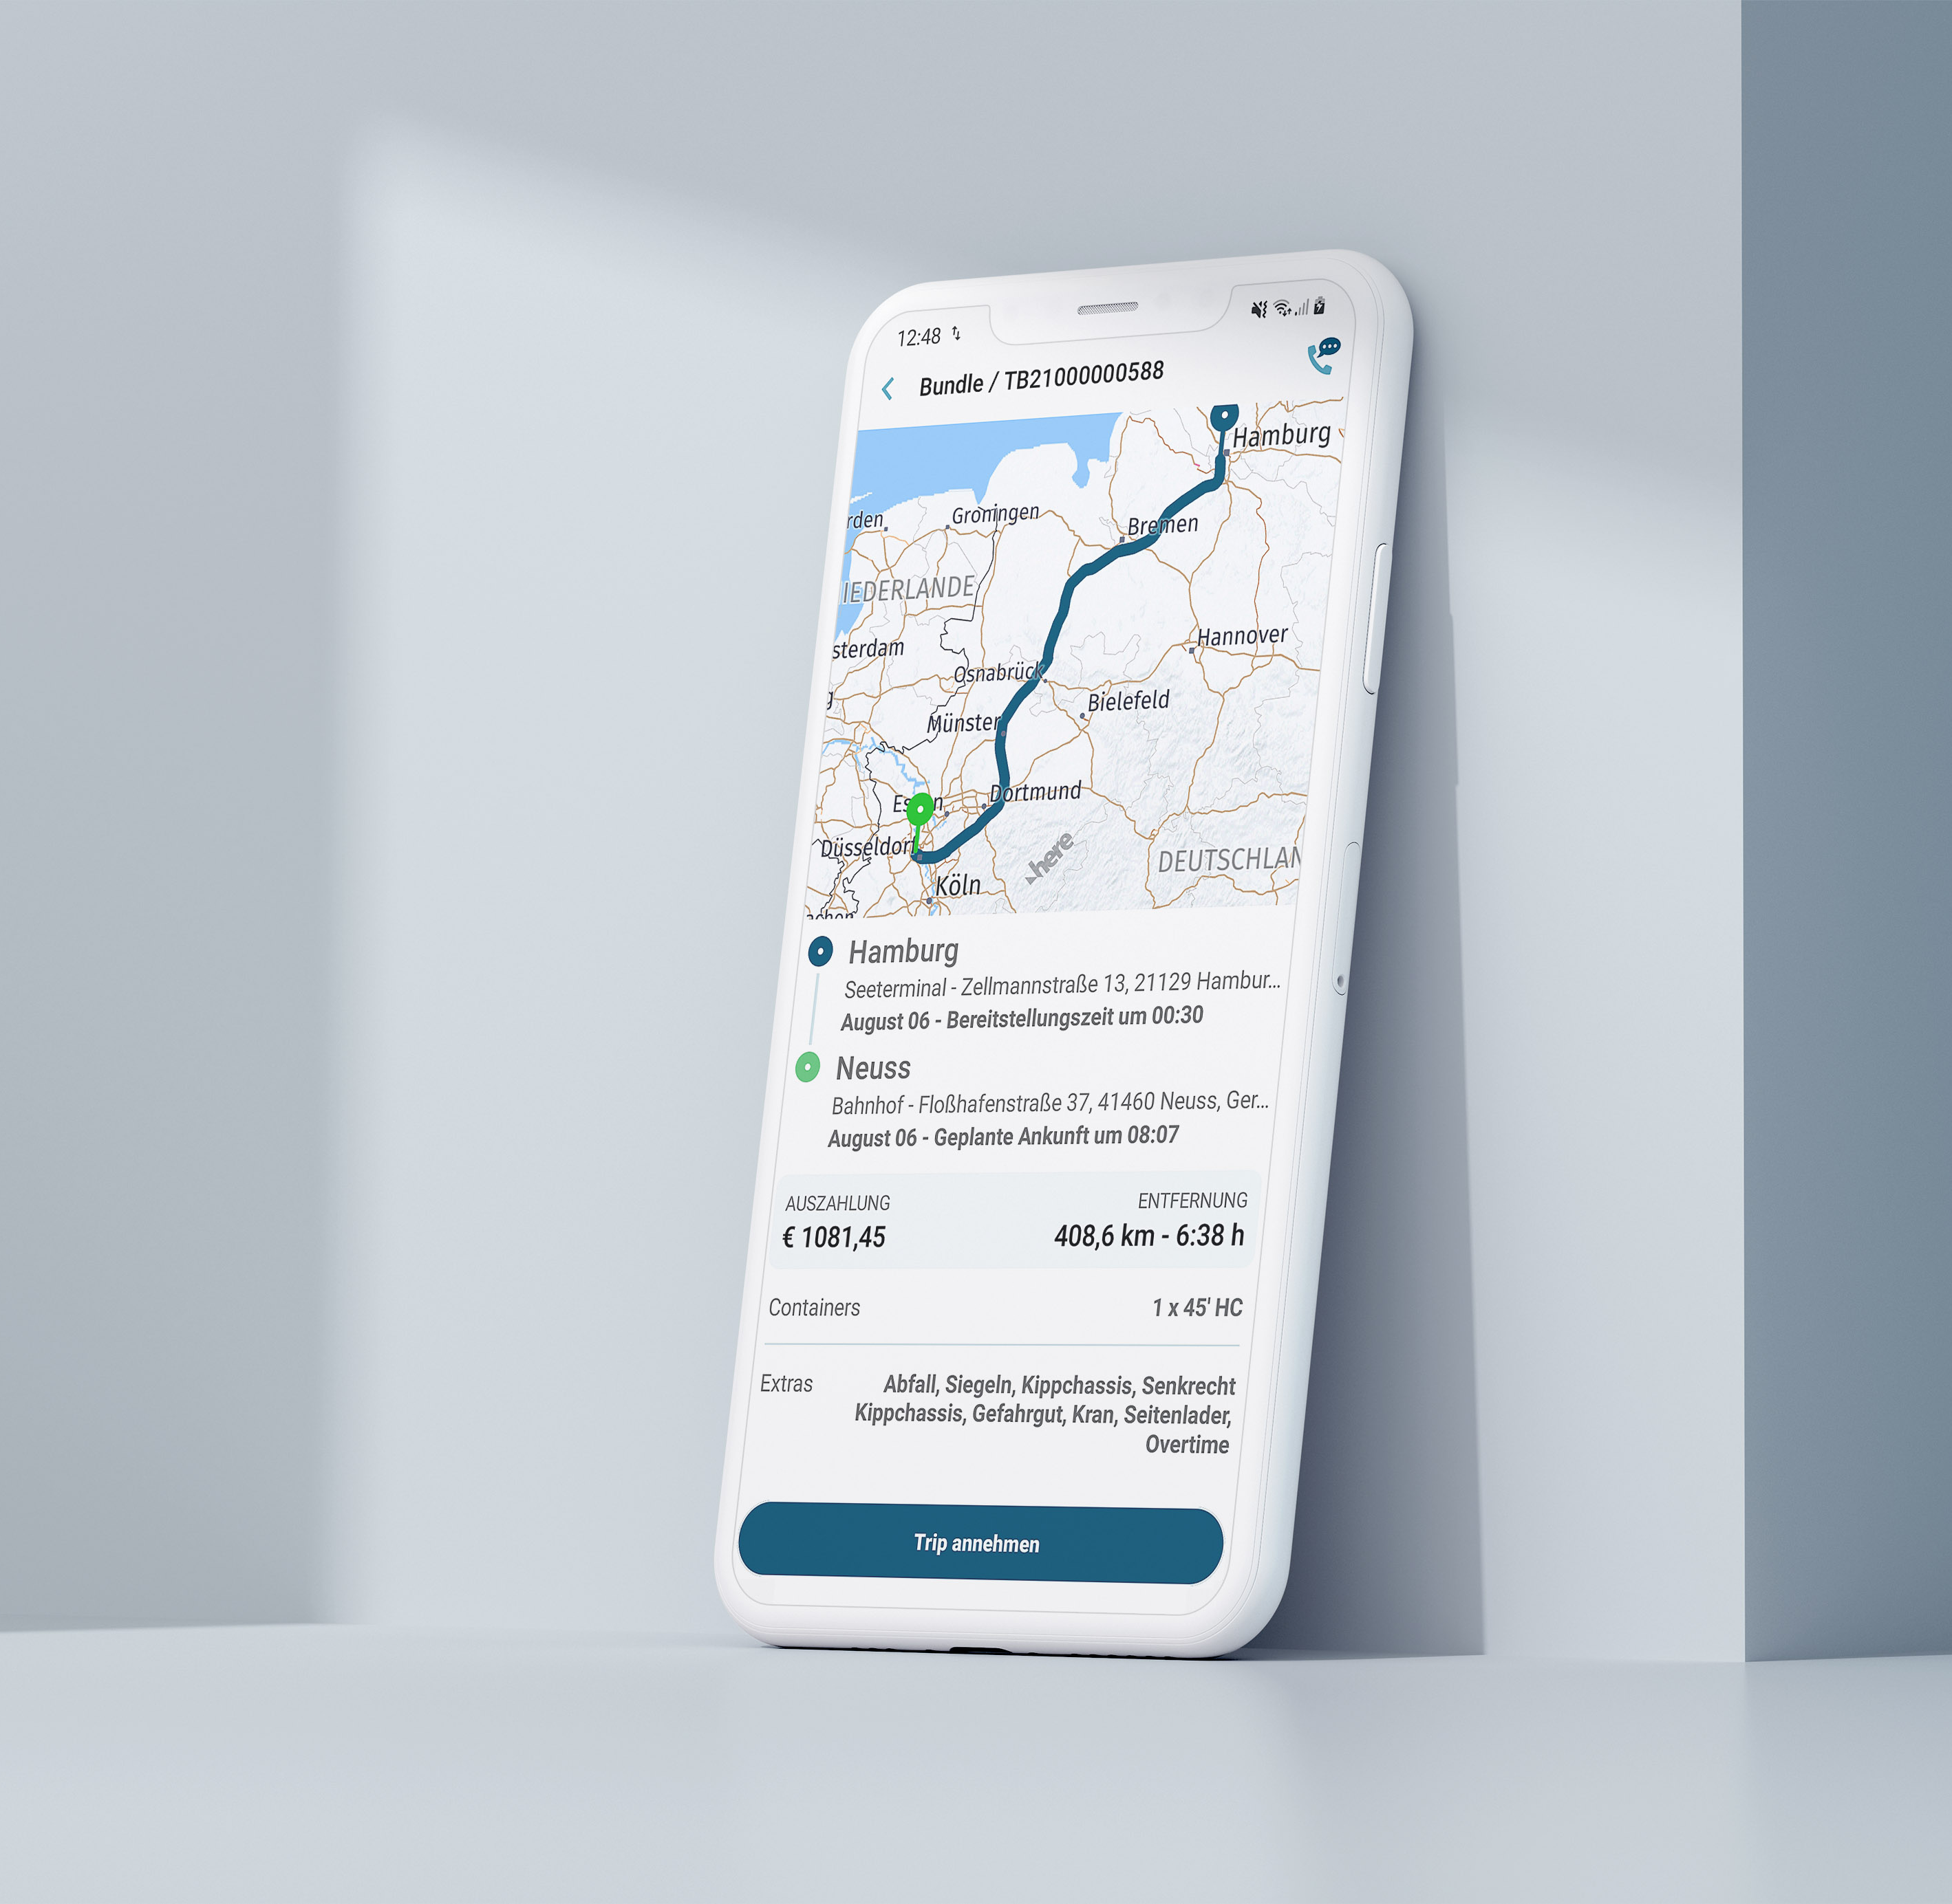

The Digital Container Trucking Platform
AUG 2023

Slide 2
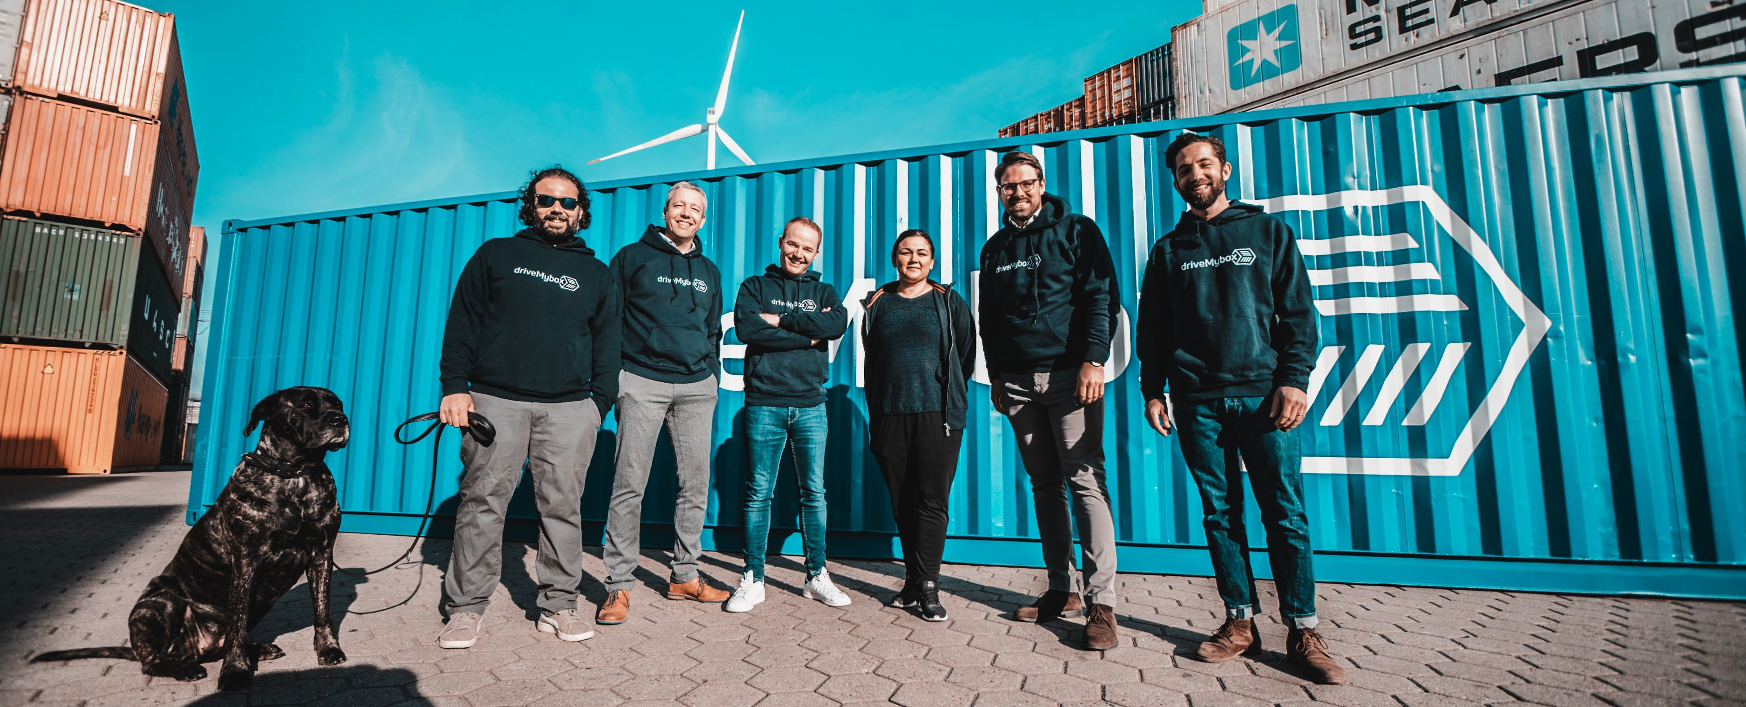
Europe's leading container trucking platform.
Founded in 2019
Go-Live 2020
> 20.000 Transports
> 1.000 Truckers
3 Offices (Hamburg, Mailand, Rotterdam)

Slide 3






Customers
One contact, one click,
one dashboard, realtime data.
Trucking Companies / Independent Truckers

Slide 4



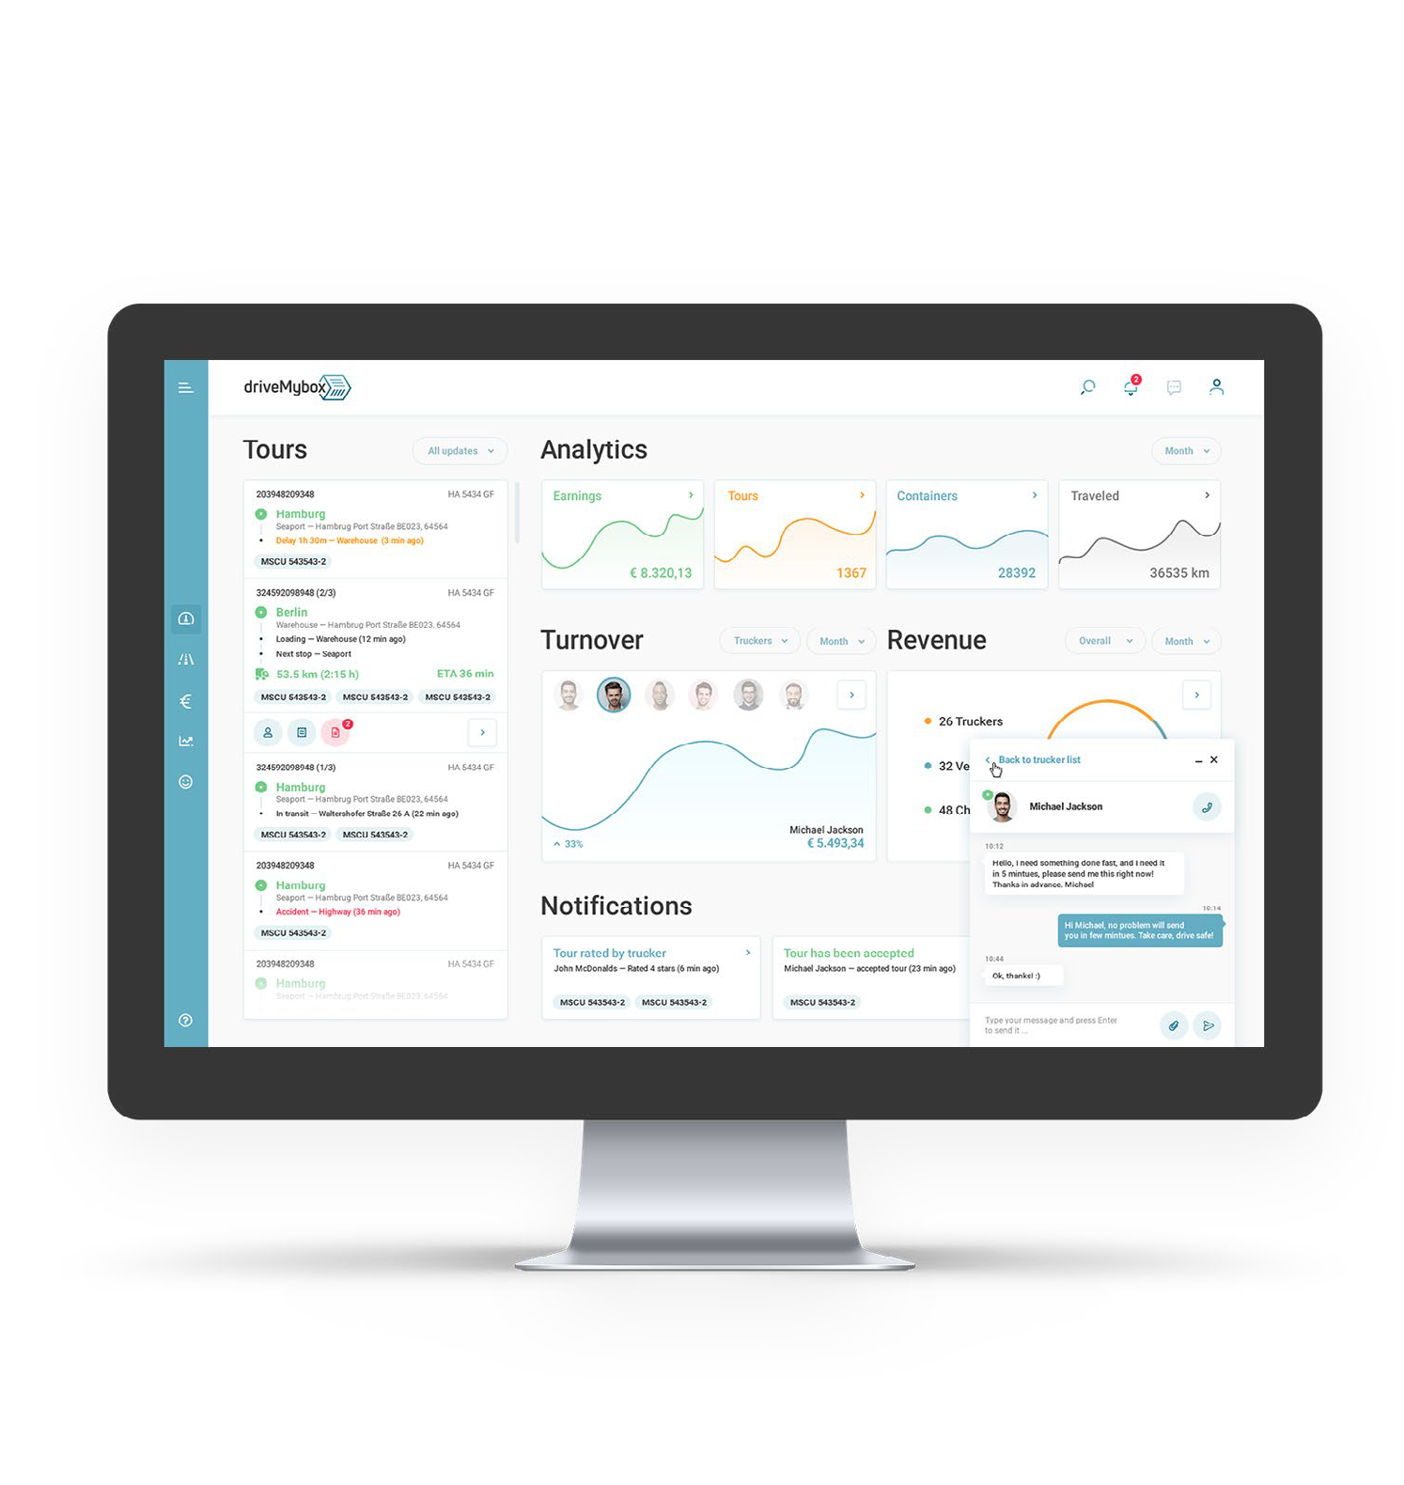
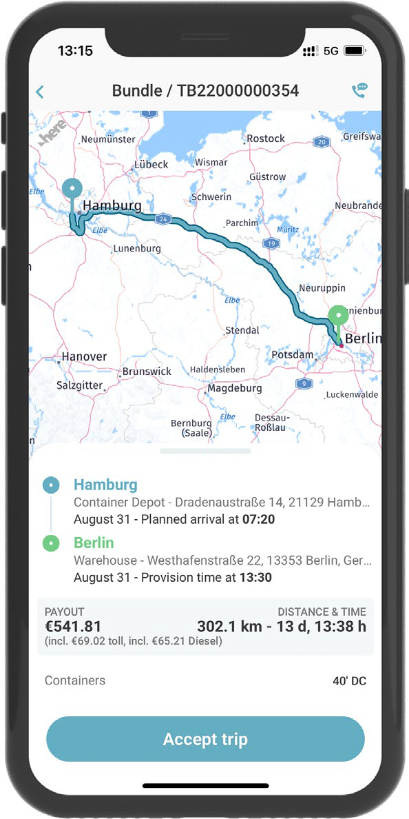
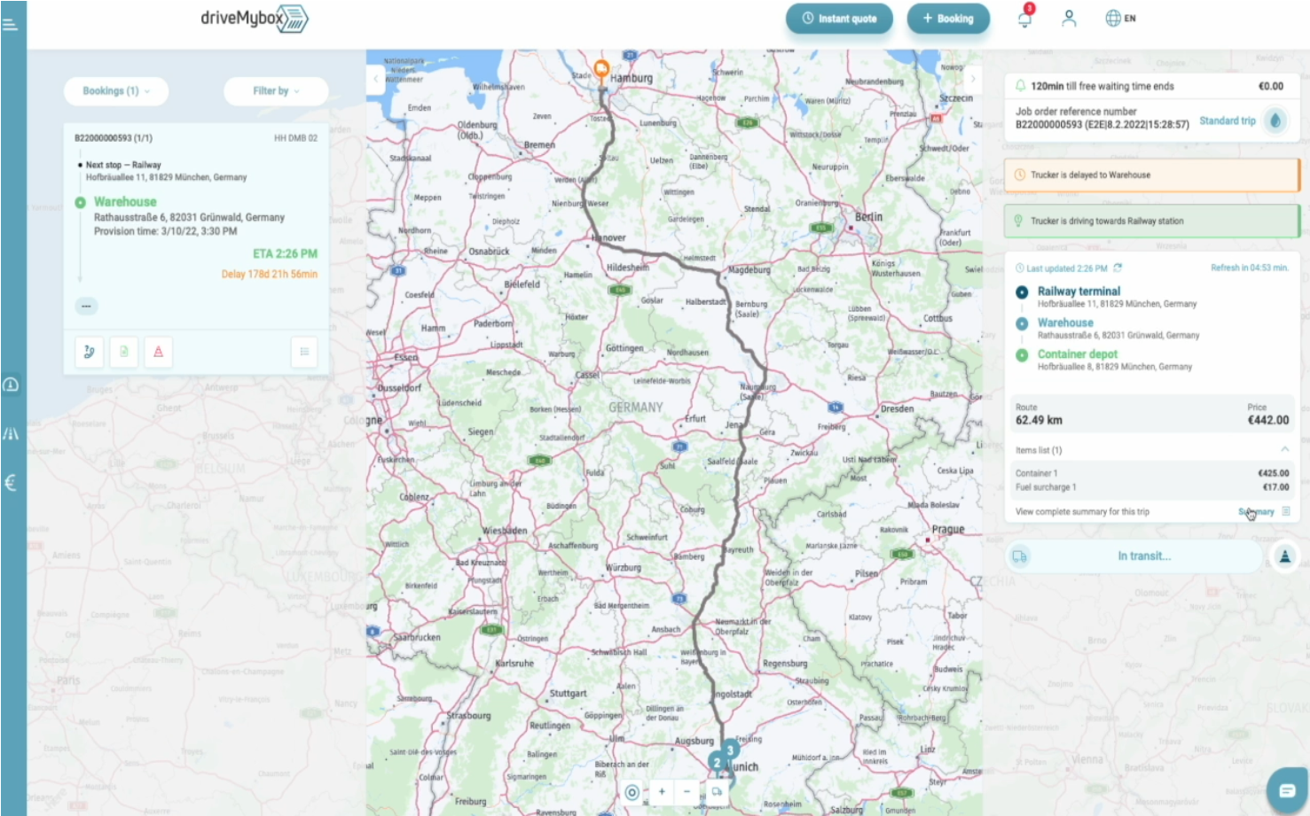

HOW OUR PLATFORM WORKS.
THE PROCESS
1
Easy booking via Web or API based.
2
AI finds the most suitable driver.
3
We enable full transparency.
4
dMb takes care 24/7 as contract partner
for both sides.
TRANSLATED INTO AN INTUITIVE PLATFORM
Customer
Dashboard to
manage transport bookings.
Truckers
App to get, accept and execute offers
and to receive information.

Slide 5
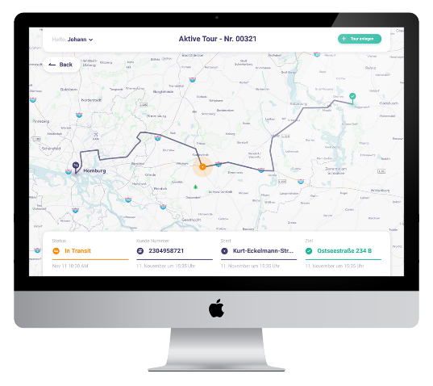

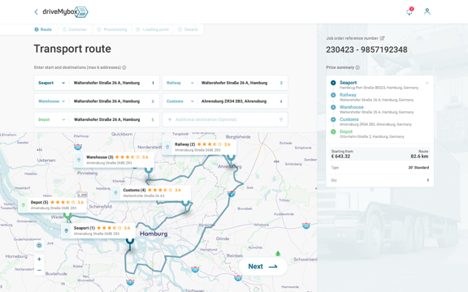

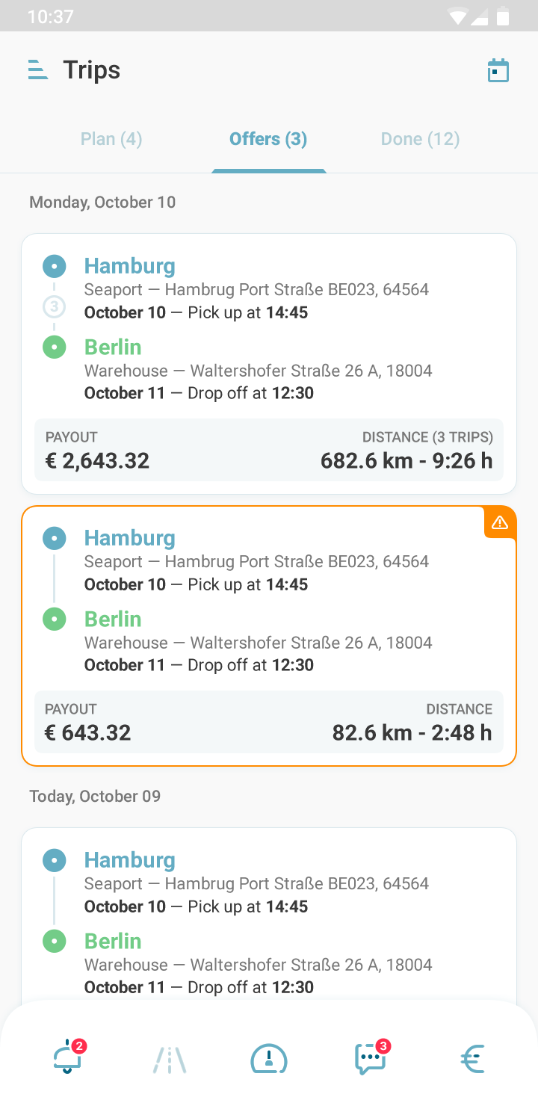
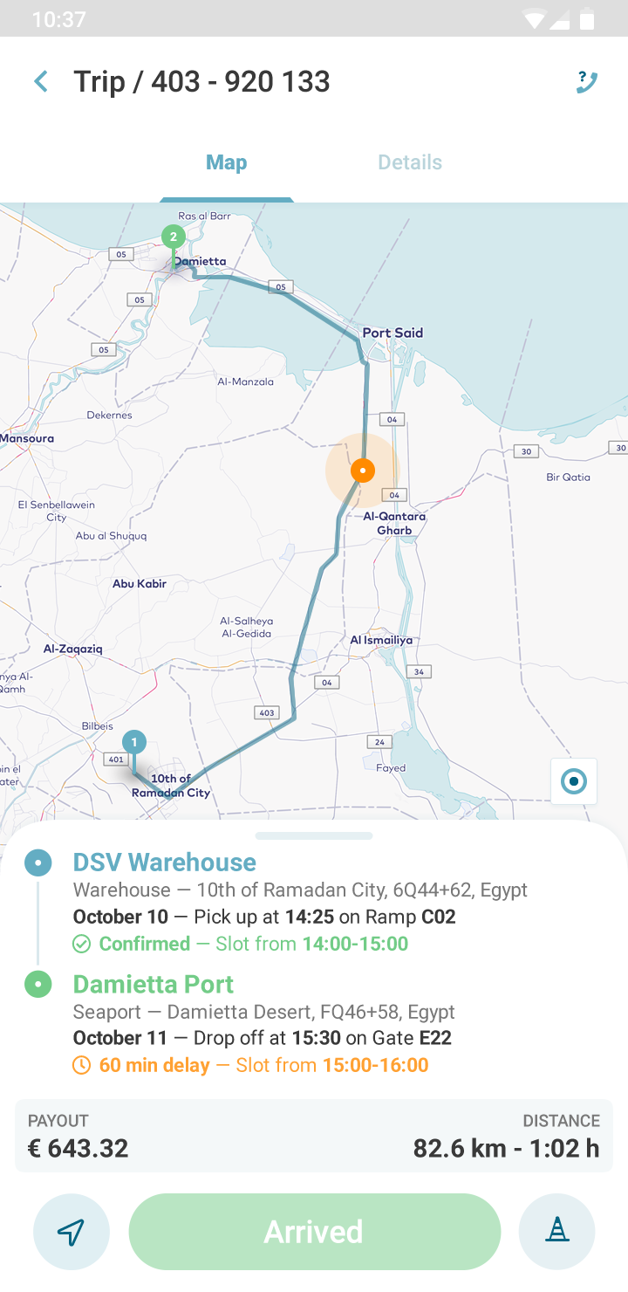
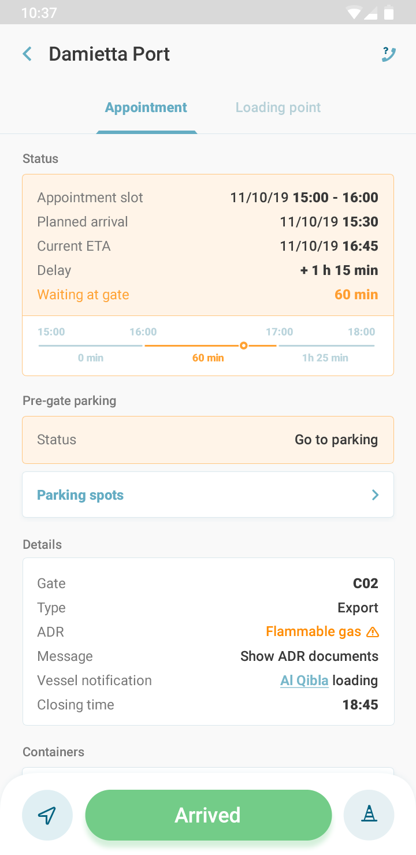




Real-Time Update
Trucker Data, Real-Time Data
Customers
Truckers
Transport Booking
Bundle Offering
Manage
Transport Bookings
Get Offer
Accept and Execute
Receive
Information
Bookings, Capacities
Operational Data
Bundle Offerings, Replacements
Analytics Services
Optimization Engine
Analytics Engine
Round-trip optimization
Trucker Matching
Dynamic re-optimizations
Data lake
Prediction models
Dynamic pricing
Image recognition
Business intelligence
Predictions
External Sources
AI Services

Slide 6
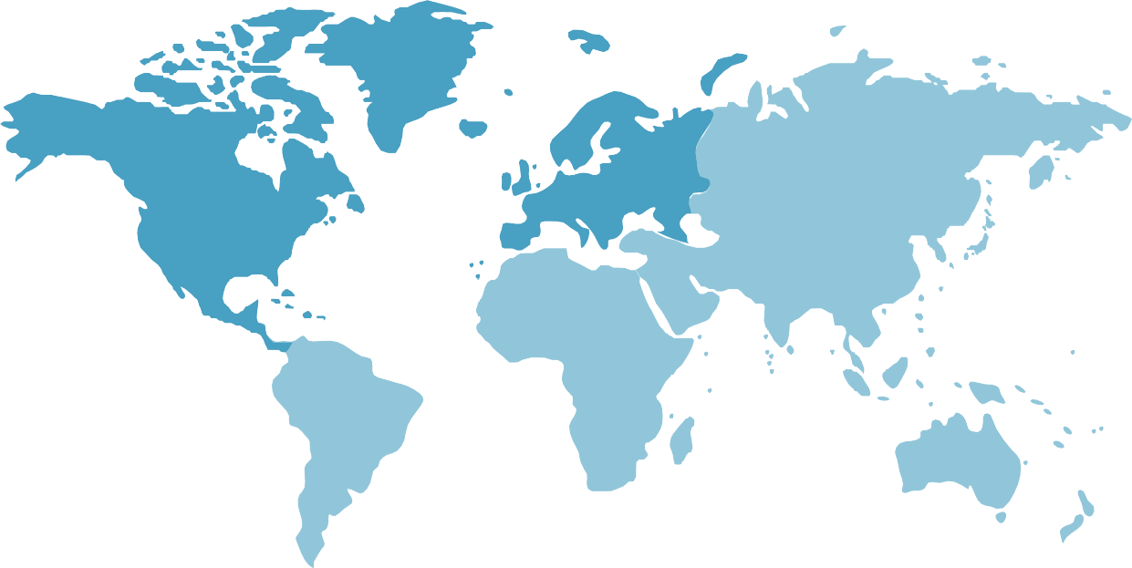













OUR STRATEGY TO SUCCEED.
Core Features
PRODUCT INNOVATION
Route and vehicle selection
Booking eco-mode ensures low GHG emissions by selecting the right route and truck. Remaining emissions can be compensated.
Al & Optimization
Tours for truckers are optimized to avoid empty trips and further reduce GHG emissions.
MARKET EXPANSION
PARTNER NETWORK
Value-Added Services
We provide additional services for customers and service providers through our partner network.

Slide 7
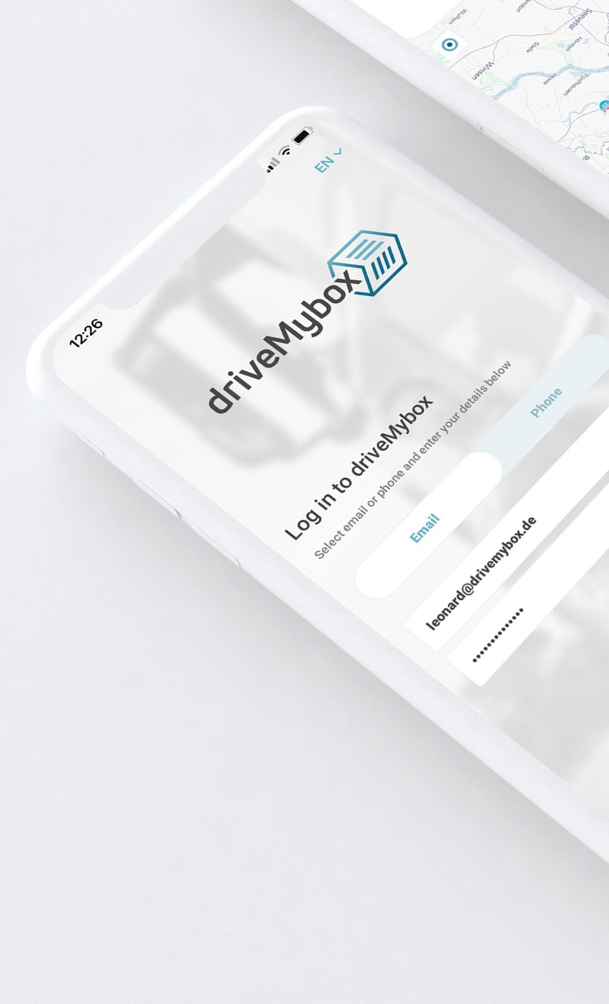


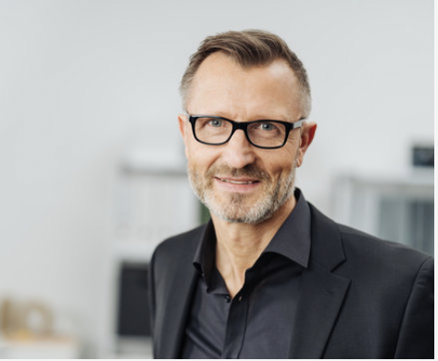

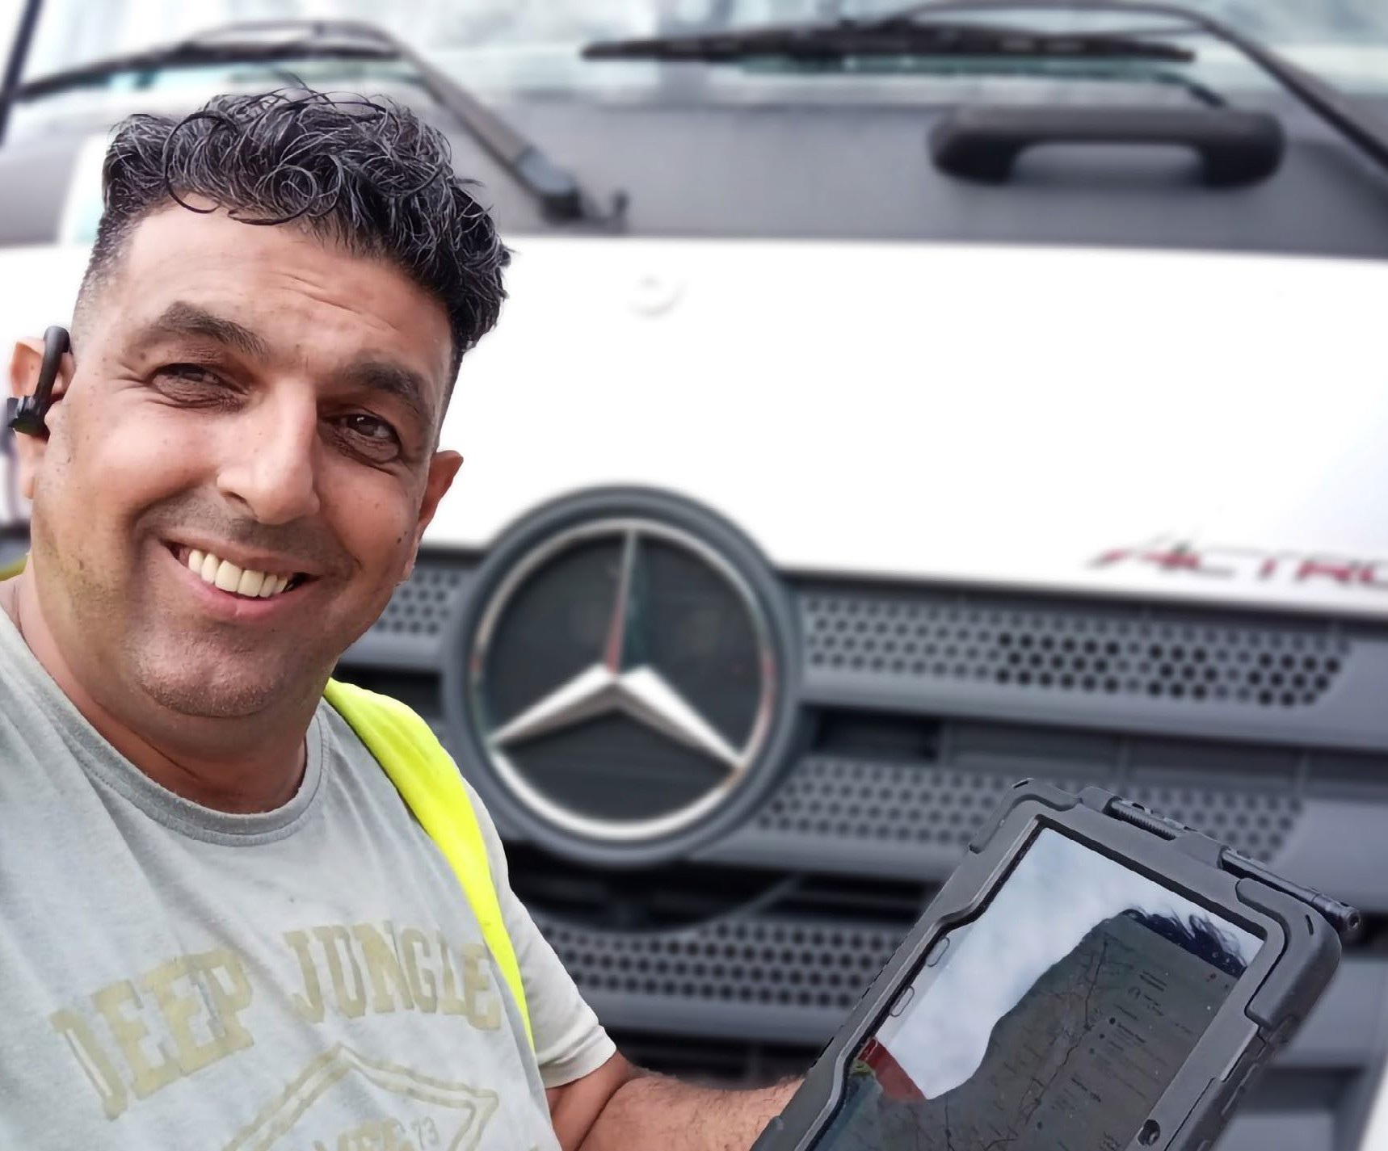
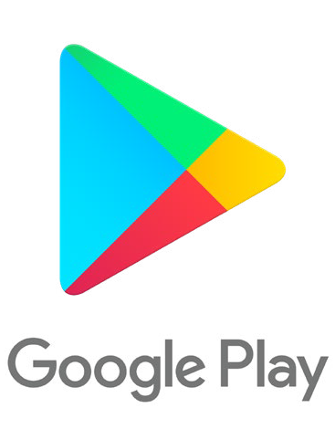
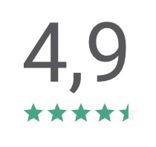

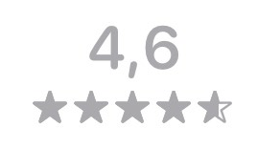
CUSTOMER VALUE.
driveMybox is my first choice! By using the platform I have much
less stress.“
Guiseppe, Trucking Company
I drive when I want, earn
more and can focus on what‘s important: driving.”
Önder, Self-Driving Entrepreneur
Finally, I don’t have to worry about my transportation anymore.” Frank, Customer

Slide 8
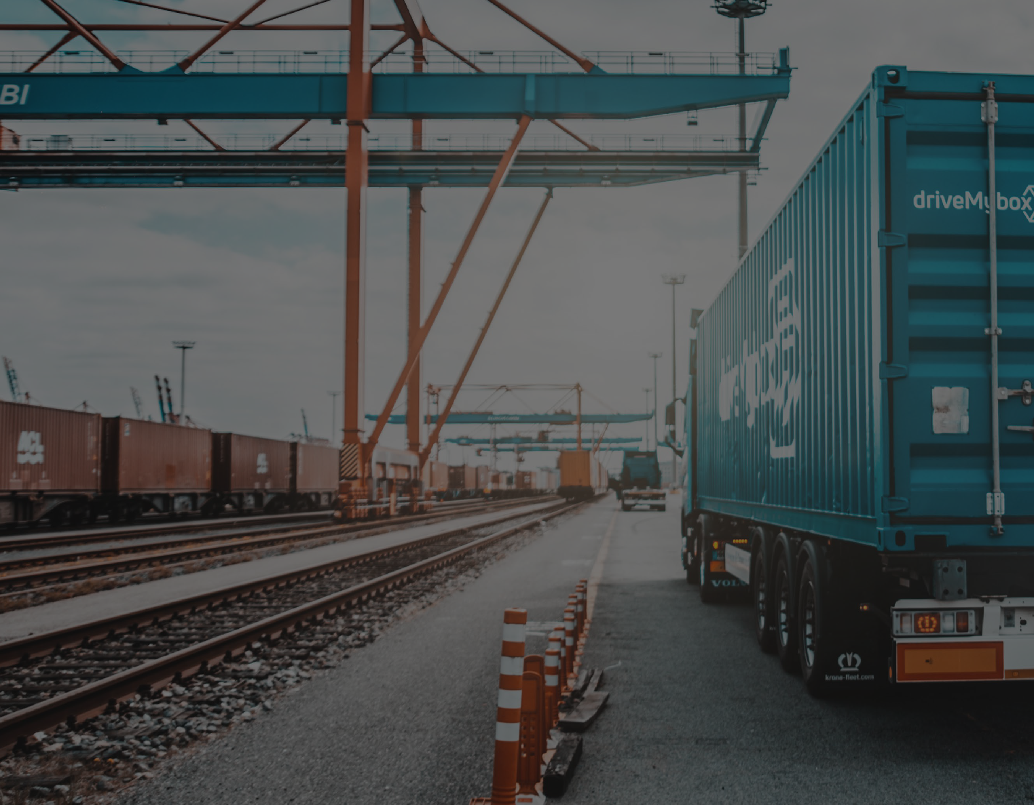

Thanks for your attention.
Questions?
Dr. Leonard Heilig
Co-Founder | Chief Technology Officer (CTO)
Mobile: +49 151 67849830

